Slide 1
CSC 1004: Tutorial 9
Snake Game Introduction and
Pycharm Installation
Guanren Qiao
SDS, CUHK-SZ

Slide 2
Basic Function
The player's goal is to control a snake to eat as much food as possible, causing the snake to grow longer.
Control its direction to find food at a fixed speed with Keyboard.
Food items randomly appear on the game board.
The game ends under the following conditions: The snake collides with the boundaries of the game area. The snake collides with its own body, essentially running into itself.
Utilizes the tkinter library to create a graphical user interface.

Slide 3
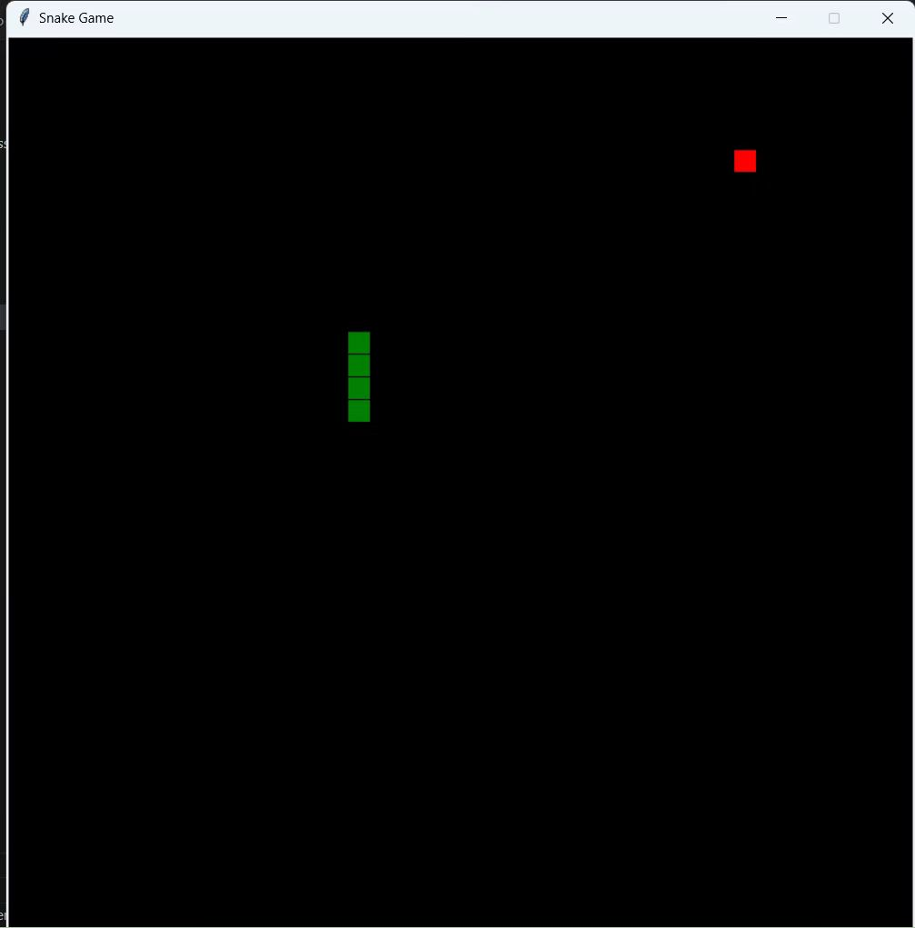
Advanced Function
Different Effects of Food (10%)
Adding Obstacles (5%)
Adding score function (5%)
Multi-Level Challenges (15%)
Dynamic velocity (10%)
Adding start menu (5%)
More exploration ...

Slide 4
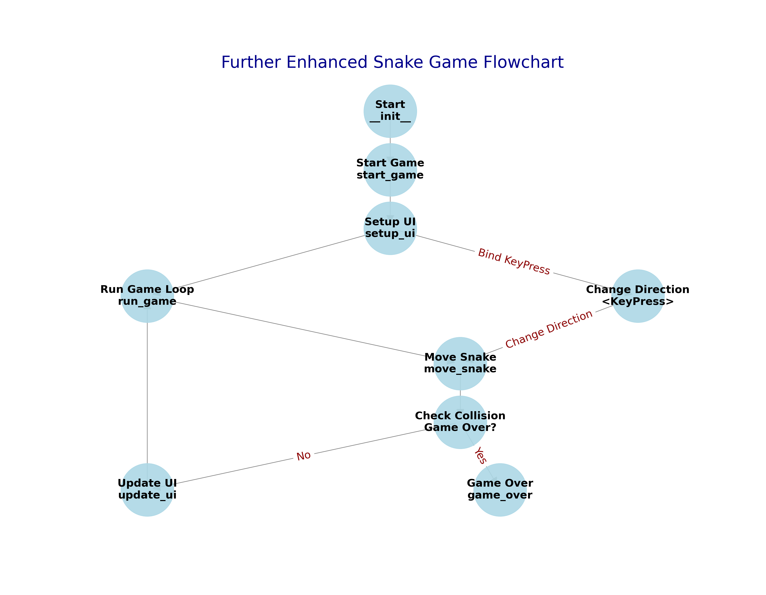
project
logic
chain

Slide 5
def create_food(self):
while True:
x = random.randint(0, (self.width//self.cell_size)-1) * self.cell_size
y = random.randint(0, (self.height//self.cell_size)-1) * self.cell_size
food = (x, y)
if food not in self.snake:
return food
project code framework
def move_snake(self):
if self.snake_direction == 'Left':
...
if new_head == self.food:
...
self.food = self.create_food()
if (new_head[0] < 0 or new_head[0] >= self.width or
new_head[1] < 0 or new_head[1] >= self.height or
new_head in self.snake[1:]):
self.game_over()
...
self.update_ui()
if __name__ == "__main__":
game = SnakeGame()
game.mainloop()
def game_over(self):
self.canvas.create_text(self.width//2, self.height//2, text="Game Over", fill="white", font=('TkDefaultFont', 24))
self.unbind("<KeyPress>")
def update_ui(self):
self.canvas.delete('all')
...
self.canvas.create_rectangle()
class SnakeGame(tk.Tk):
def __init__(self):
super().__init__()
self.title("Snake Game")
self.geometry("800x800")
self.resizable(False, False)
...
self.start_game()
def run_game(self):
self.move_snake()
self.after(100, self.run_game)
def change_direction(self, event):
...
self.snake_direction = event.keysym
def start_game(self):
...
self.setup_ui()
self.run_game()
def setup_ui(self):
self.update_ui()
self.bind("<KeyPress>", self.change_direction)

Slide 6
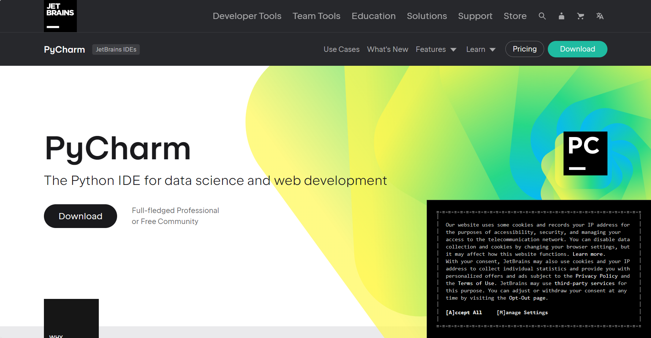
Pycharm
Enter website: https://www.jetbrains.com/pycharm/

Slide 7
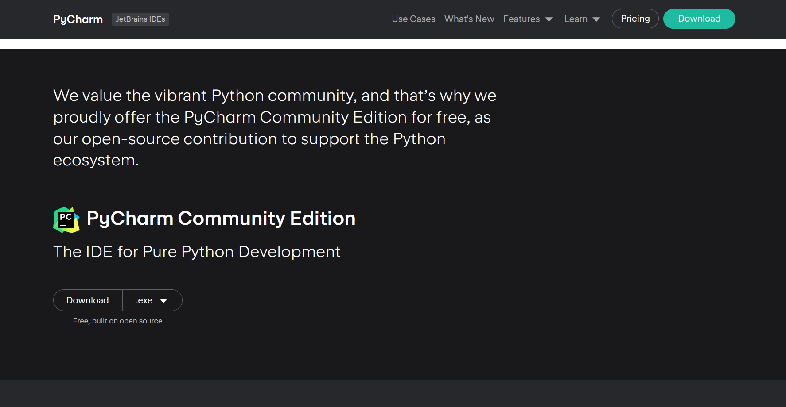
Pycharm
Download the Pycharm

Slide 8
Pycharm
click the pycharm installation exe file

Slide 9
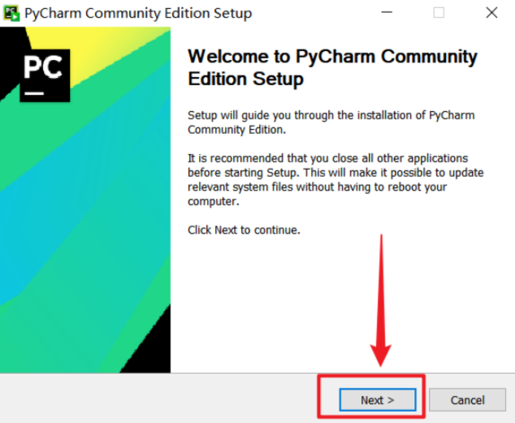
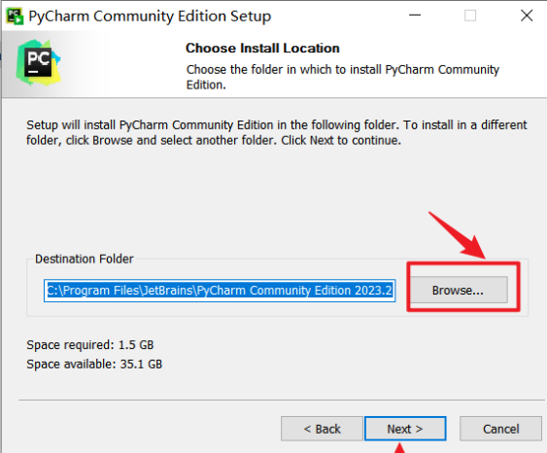
Pycharm
click next to continue and customizable installation path.

Slide 10
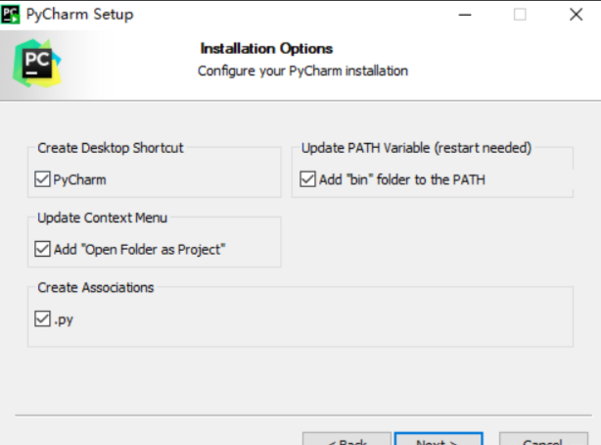
Pycharm
choose pycharm conmmunity edition、add launchers dir to the path、add open folder as project and create association option

Slide 11
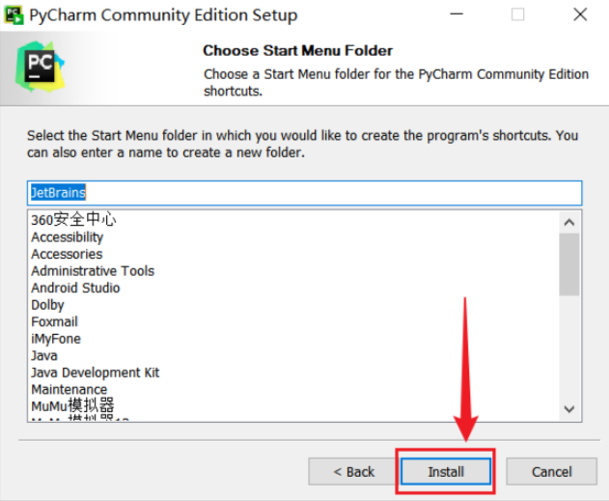
Pycharm
Keep default settings, click Install.

Slide 12
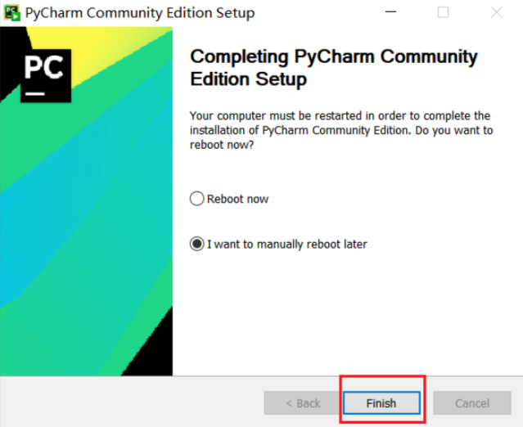
Pycharm
wait the installation process and
click finish button. You can check the
pycharm in your desktop.

Slide 13
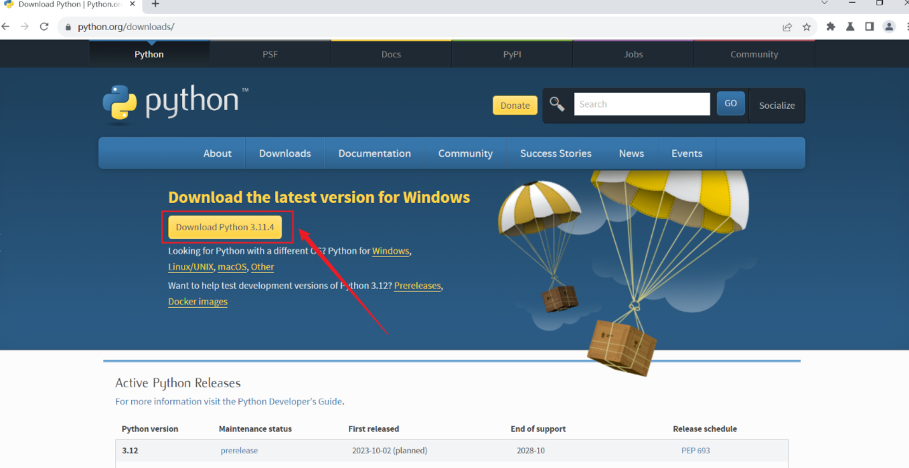
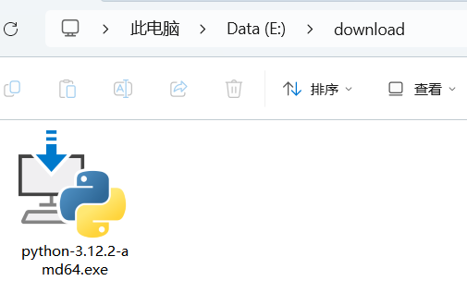
Python download and installation
website: https://www.python.org/downloads/ Locate the .exe file for Python in the downloads folder

Slide 14
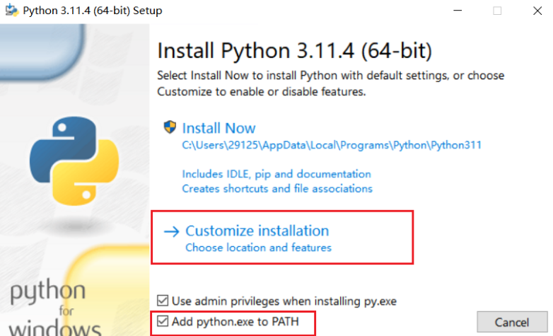
Python
Check the 'Add python.exe to PATH' option and select the 'Customize' button.

Slide 15
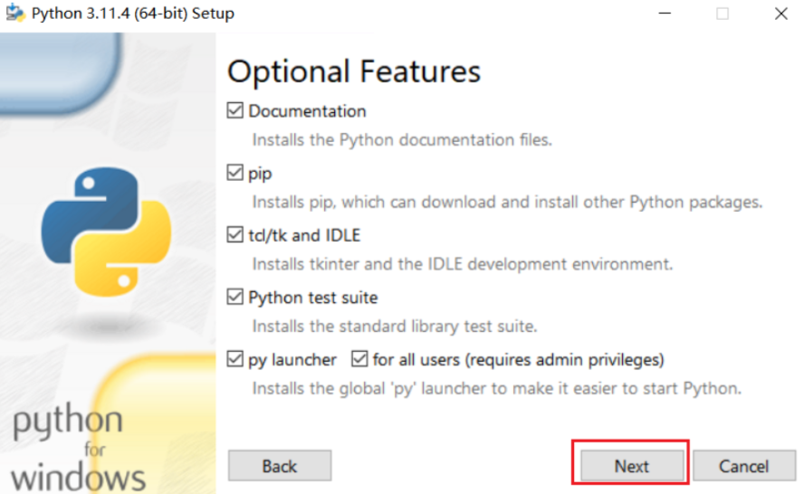
Python
Keep the default settings and
click Next

Slide 16
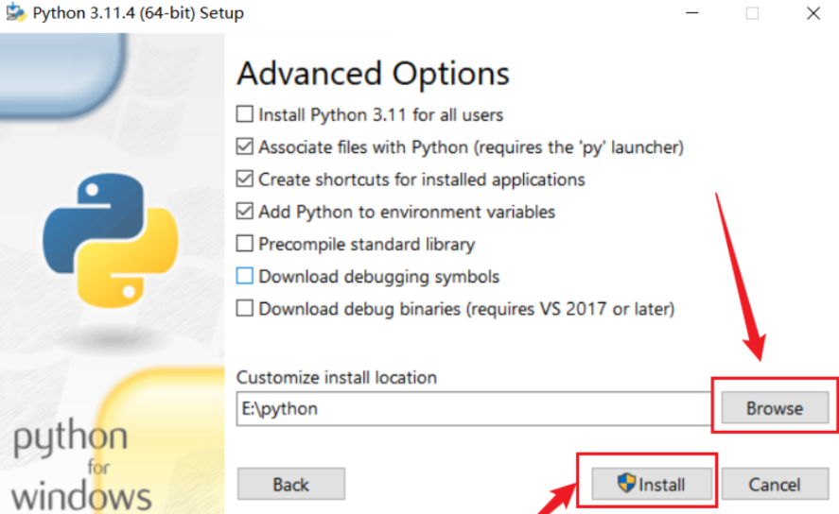
Python
Modify the installation path (remember this path), then click Install.

Slide 17
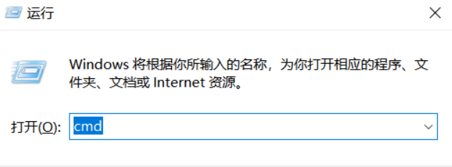
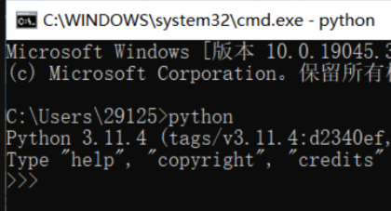
Python
Wait for the installation program to complete, then click Close to finish the installation. Open the command prompt: Press the Windows key + R on your keyboard -> Type 'cmd' -> Click OK

Slide 18
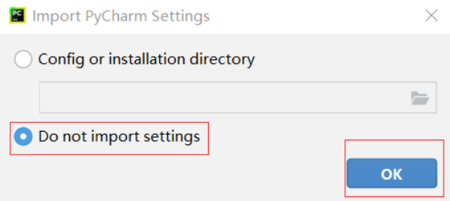
Python
If the 'Import PyCharm Settings' page appears, check 'Do not import settings', then click OK.

Slide 19
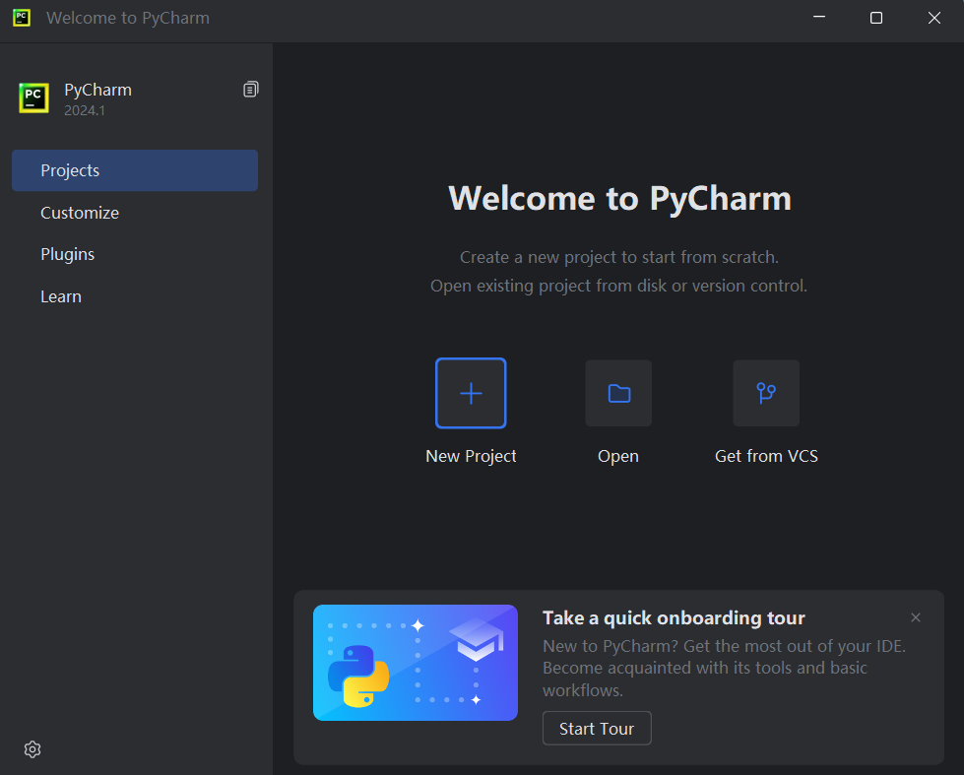
Pycharm
Click 'New Project' to create
a new project.

Slide 20
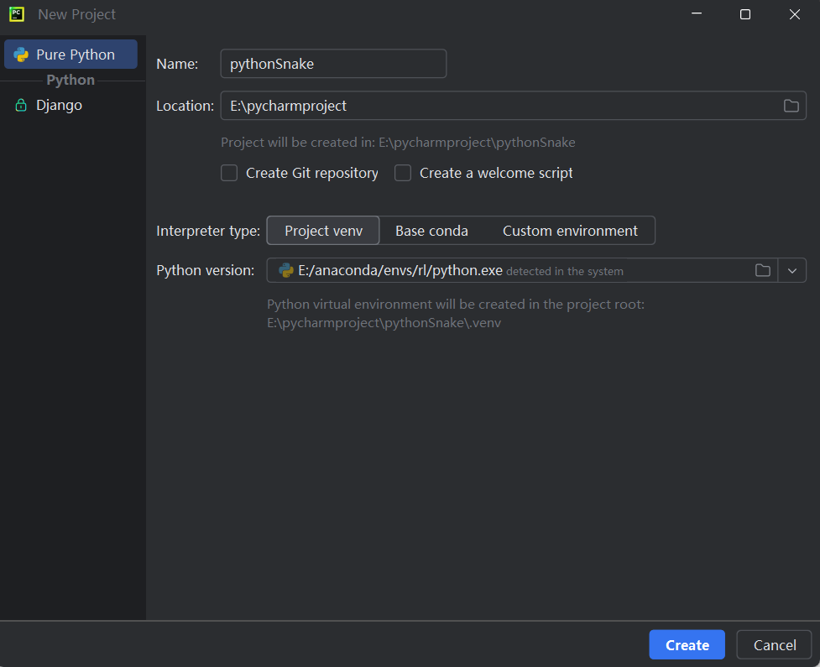
Pycharm
Make sure the project name does not conflict with any library names, then click 'Create'.

Slide 21
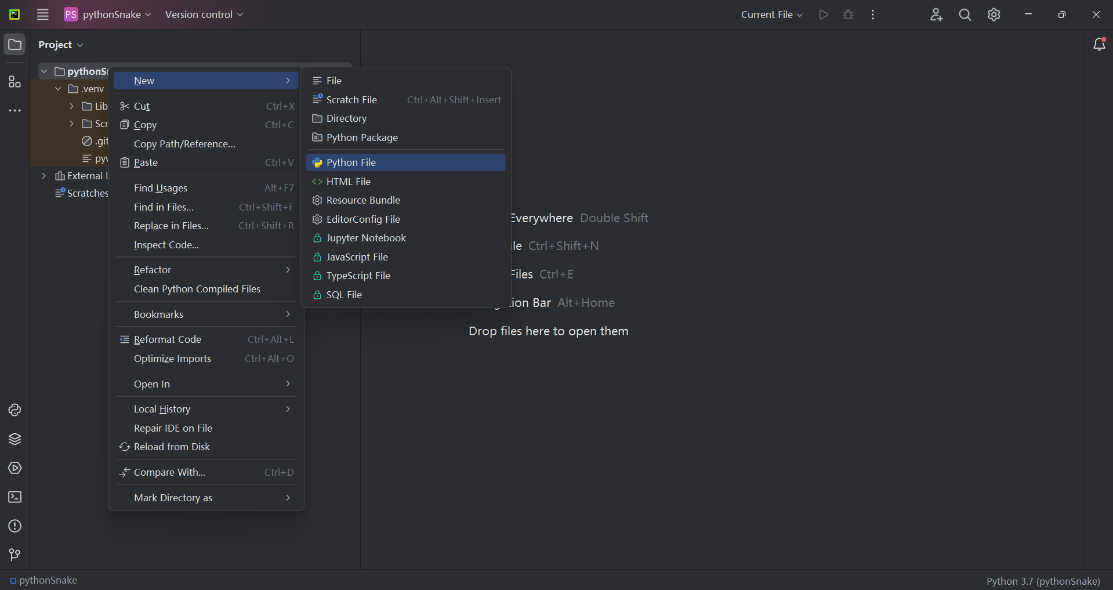
Python

Slide 22
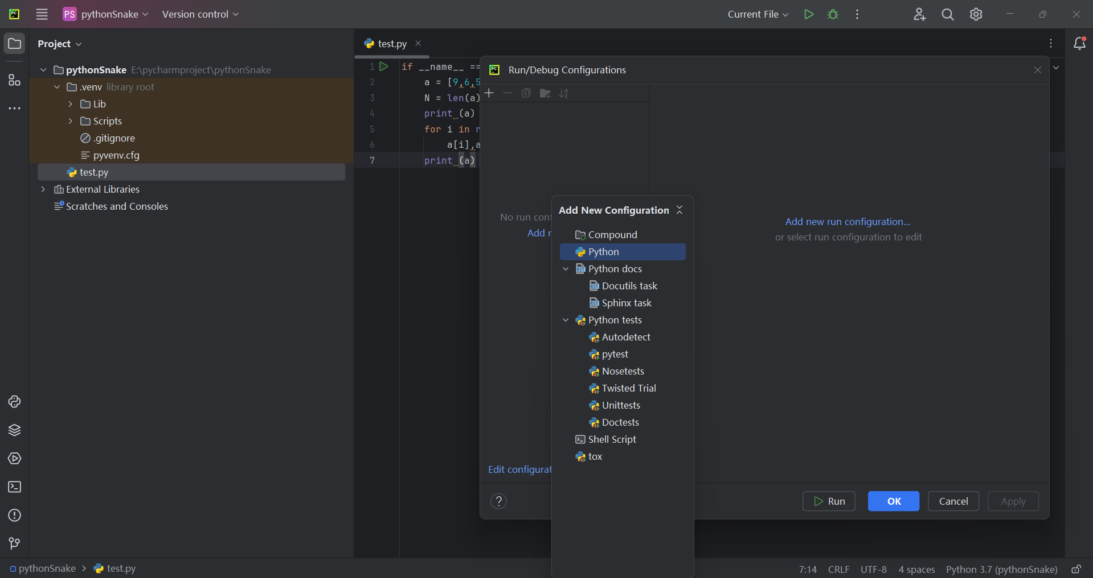
Python
click the green triangle button to import file configuration

Slide 23
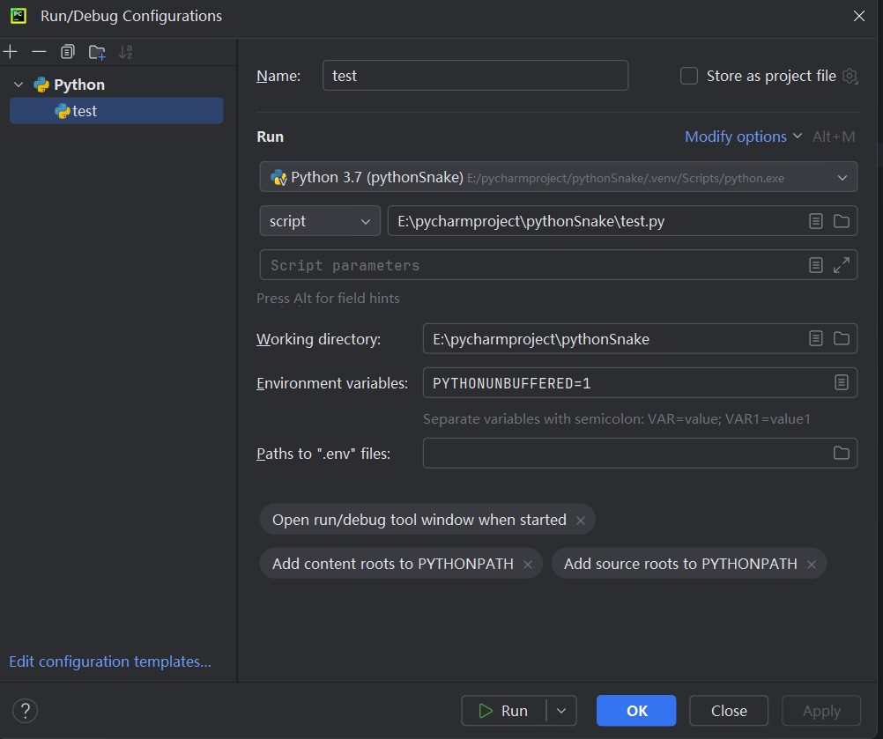
Pycharm
Run/Debug Configurations

Slide 24
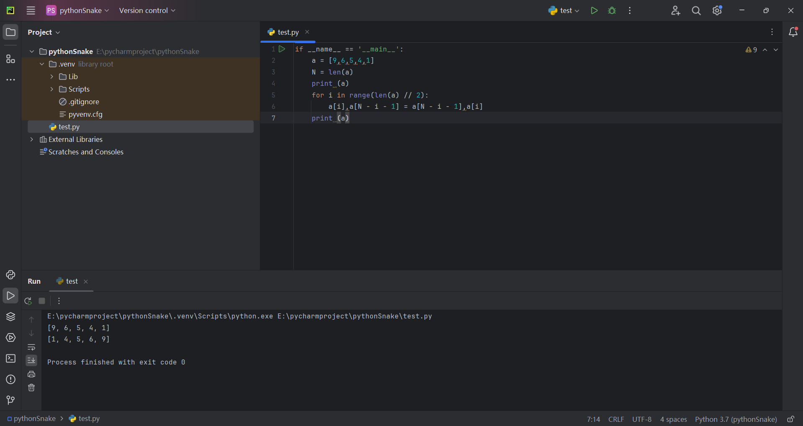
Pycharm
execute
successfully

Slide 25
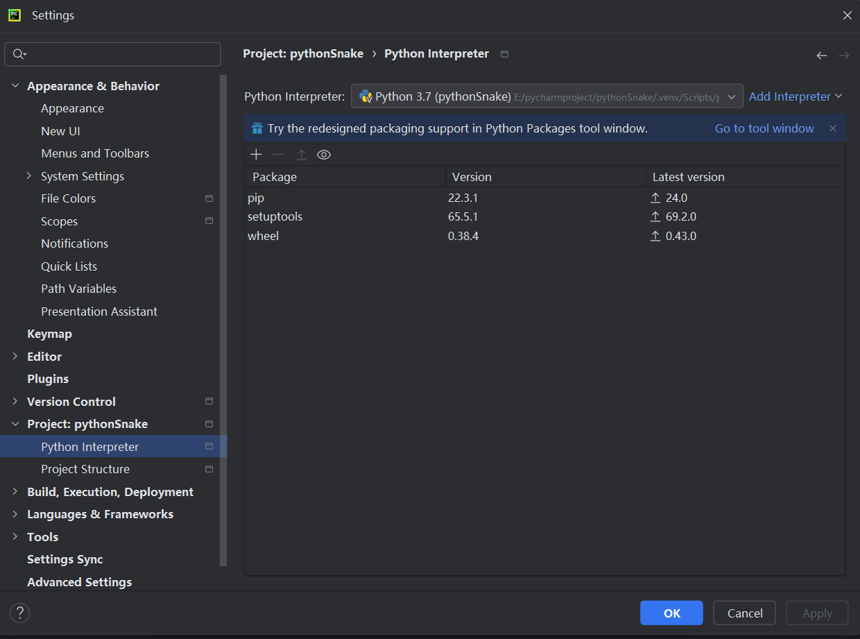
Pycharm
Click on the menu icon at the top left corner, then click on 'Settings' to enter the settings interface.
In the settings interface, 1. Click on 'Project', 2. Click on 'Python Interpreter', 3. Click on the '+' button.

Slide 26
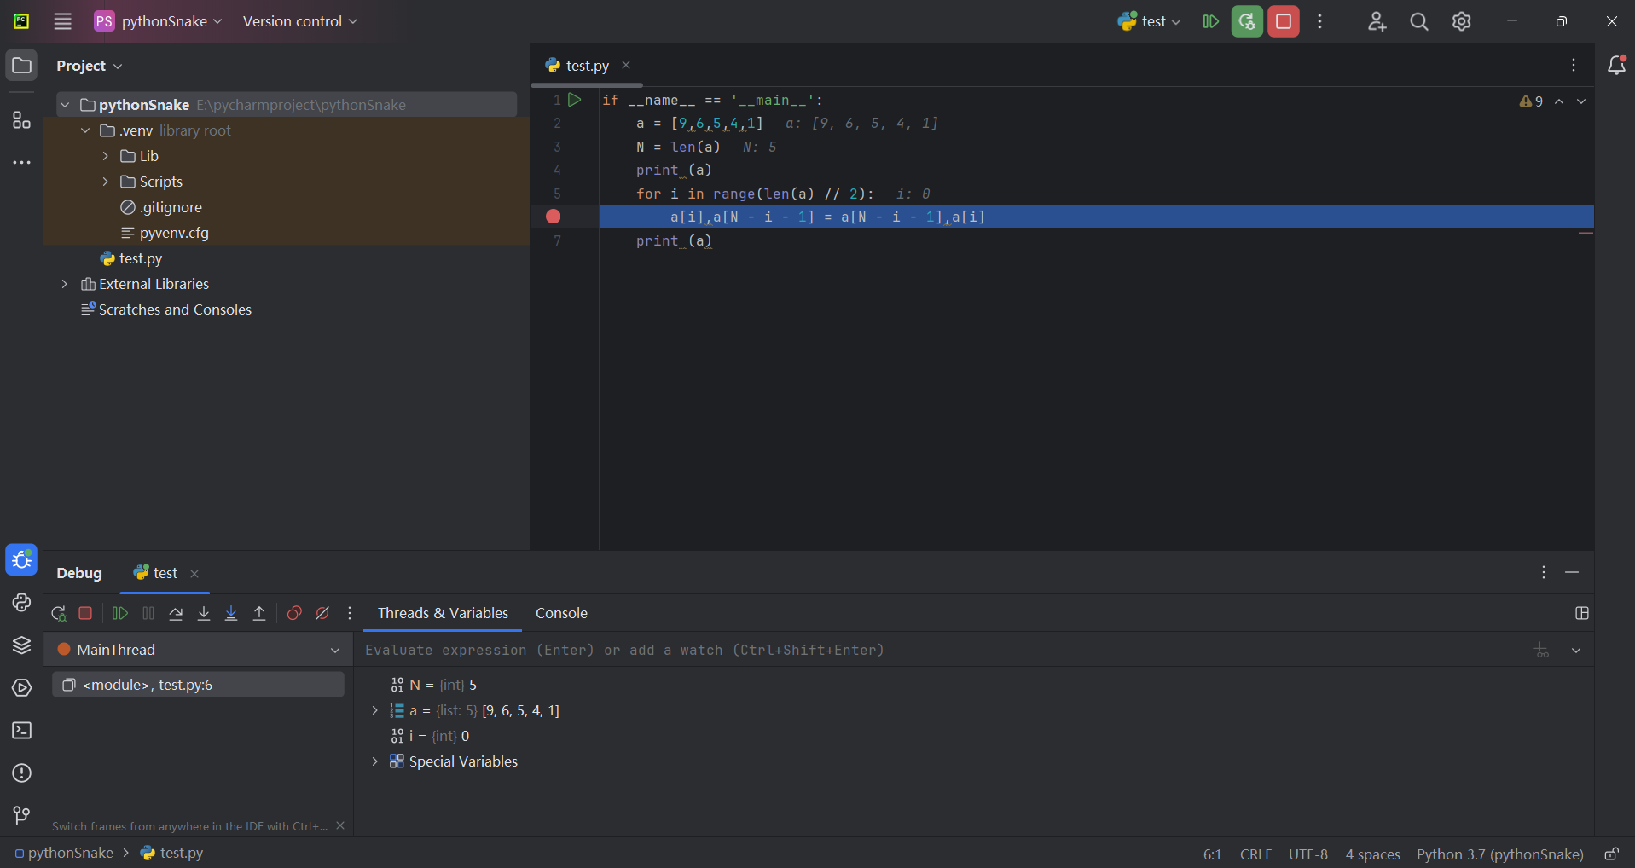
Pycharm
set breakpoint
and click
button to start
debug mode

Slide 27
THE END
THANKS

